Slide 1


Slide 2


Slide 3
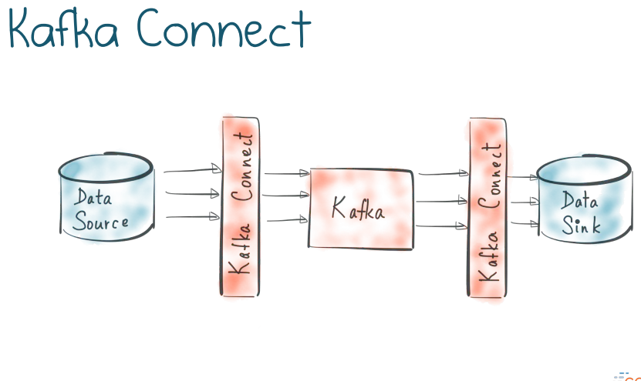

Introducing Kafka Connect
Large-scale streaming data import/export for Kafka

Slide 4
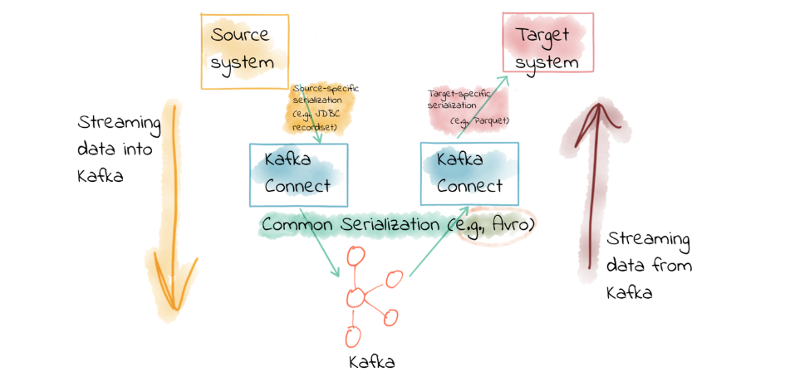

Slide 5
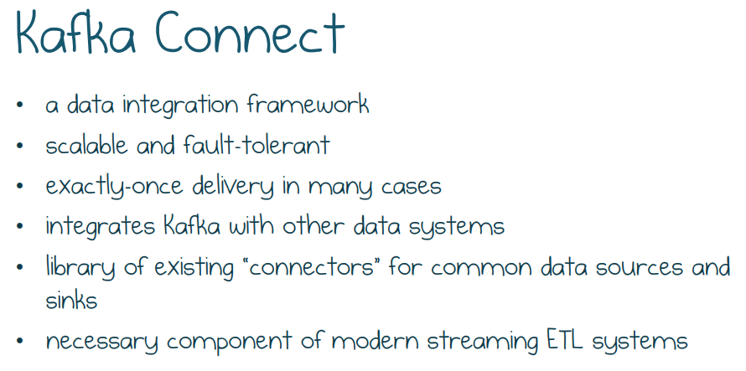

Slide 6
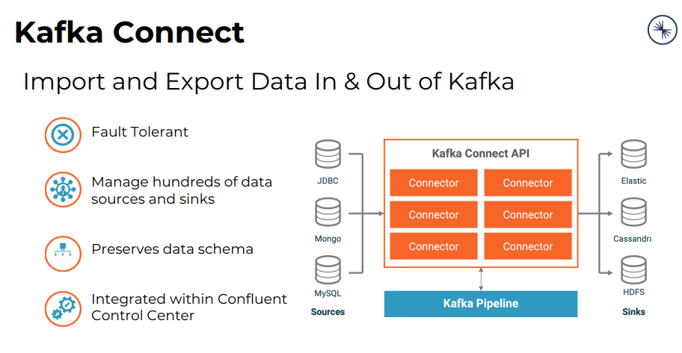


Slide 7
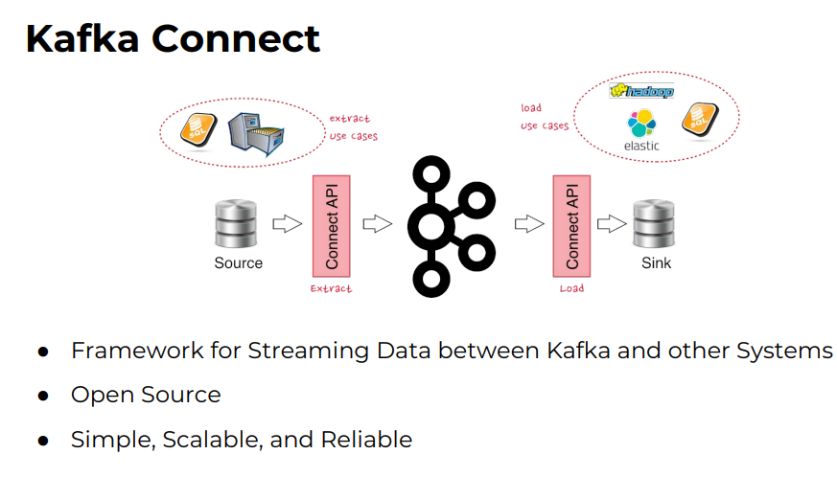

Slide 8
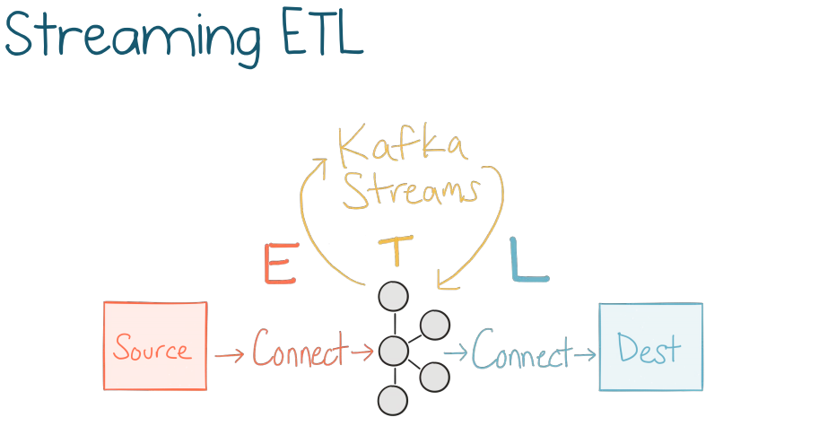

Slide 9
Modes
Standalone mode is useful for development and testing Kafka Connect on a local machine. It can also be used for environments that typically use single agents (for example, sending web server logs to Kafka).
Distributed mode runs Connect workers on multiple machines (nodes). These form a Connect cluster. Kafka Connect distributes running connectors across the cluster. You can add more nodes or remove nodes as your needs evolve.

Slide 10
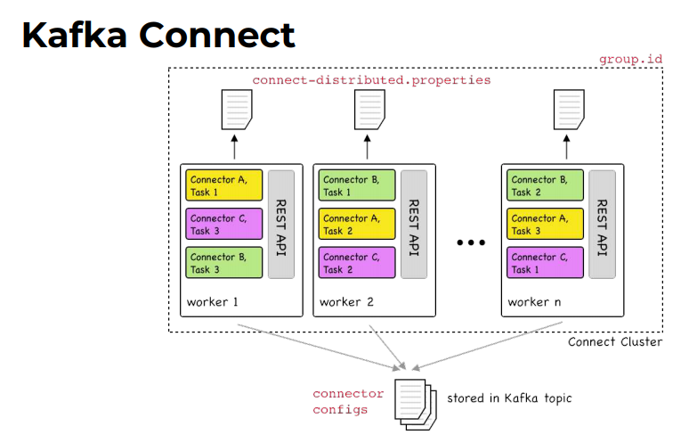

Slide 11
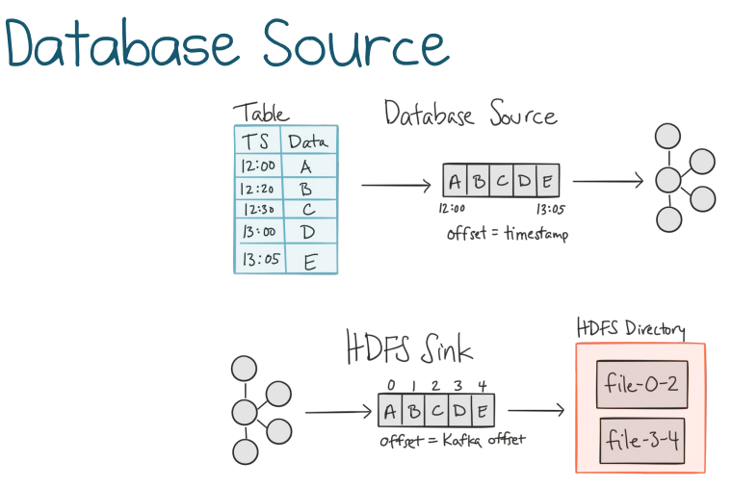

Slide 12
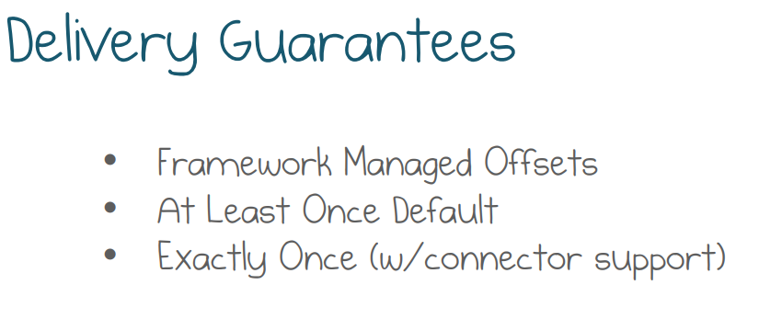

Slide 13
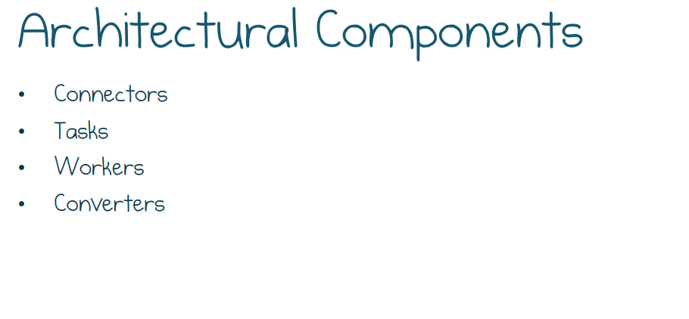

Slide 14
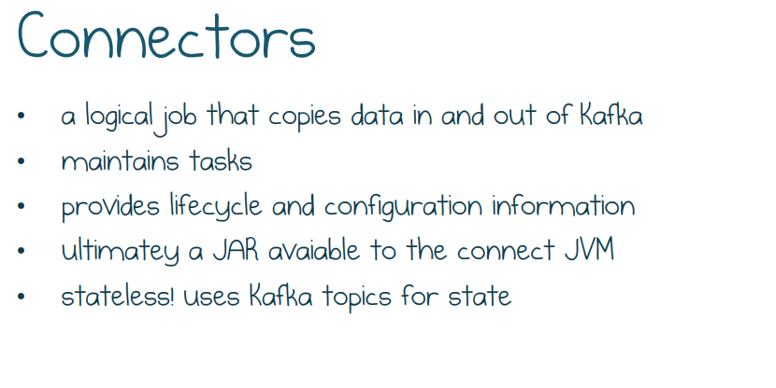

Slide 15
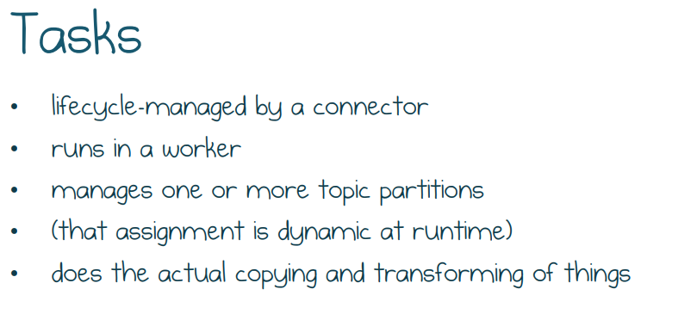

Slide 16
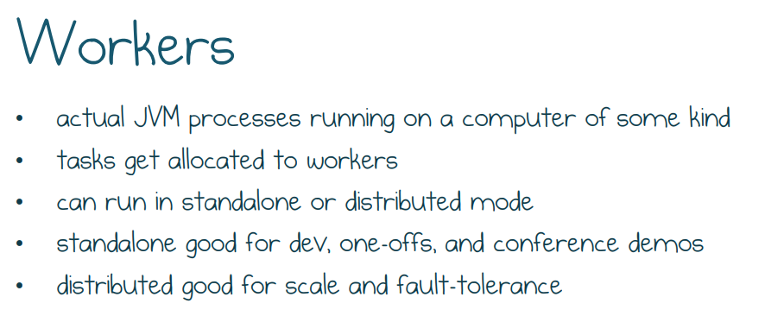

Slide 17
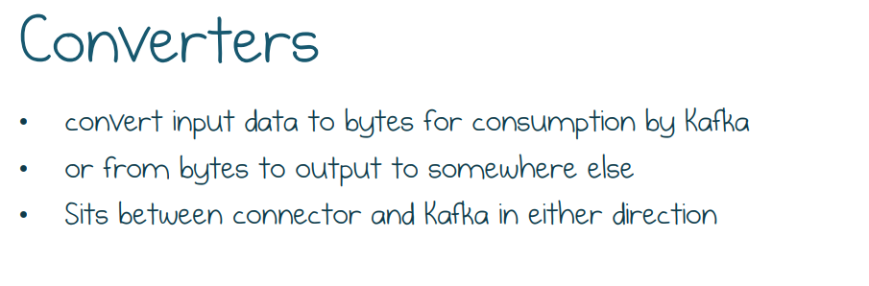

Slide 18
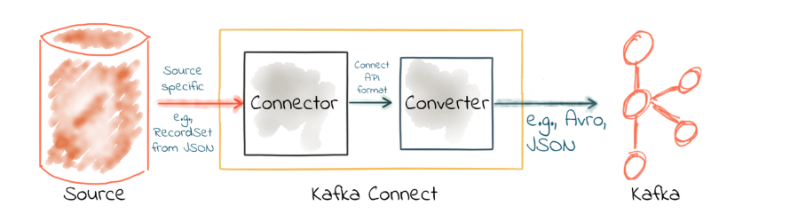

Slide 19
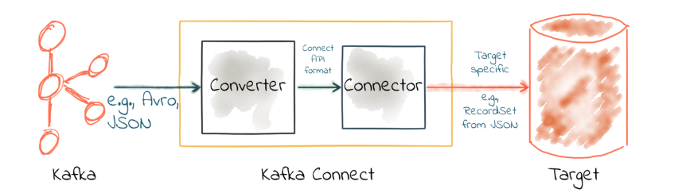

Slide 20
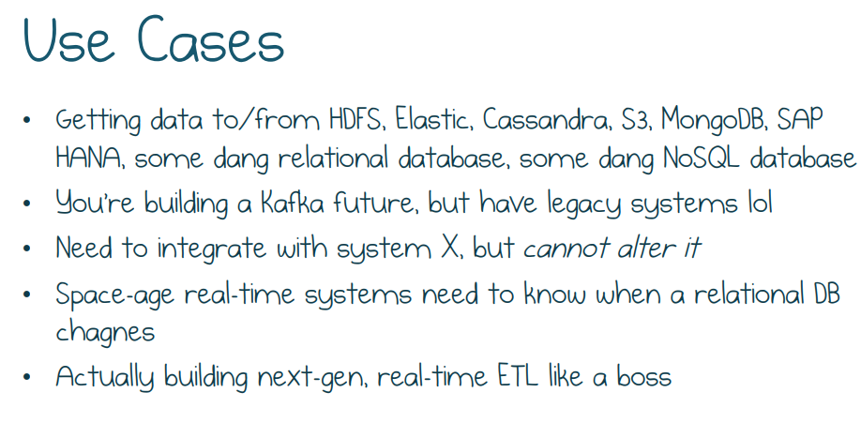

Slide 21

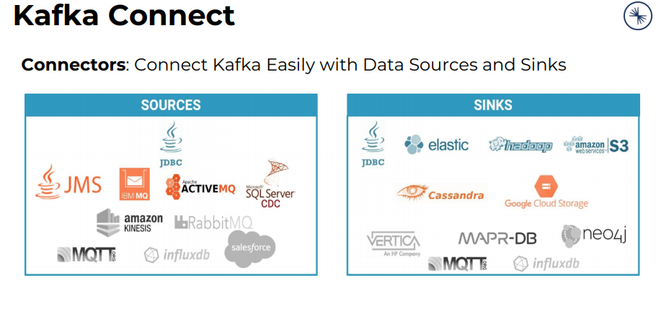

Slide 22
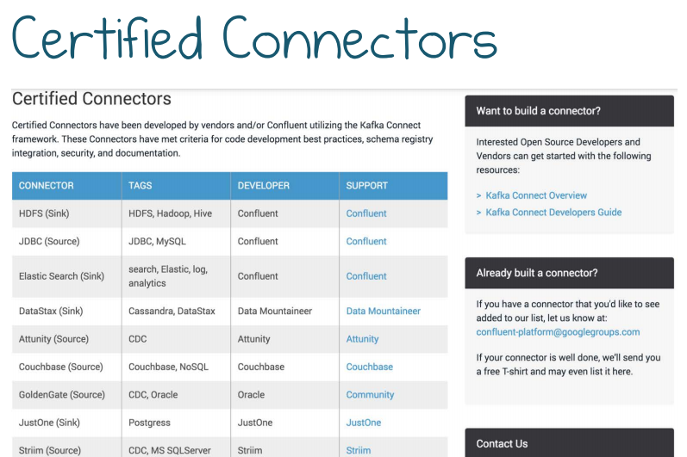

Slide 23
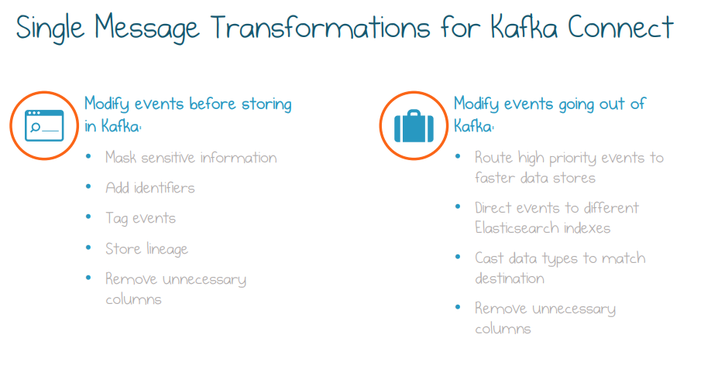

Slide 24
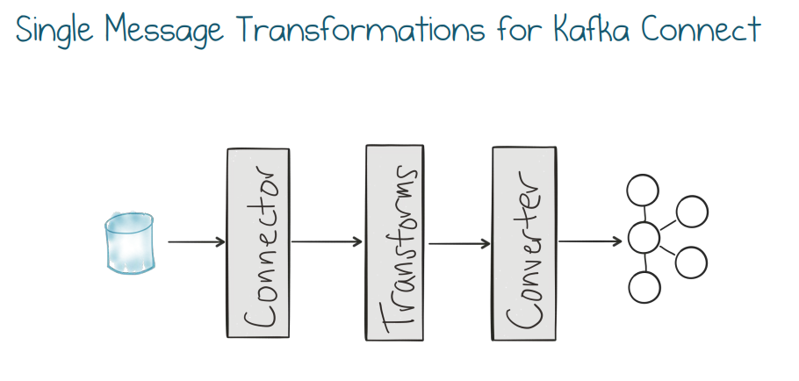

Slide 25
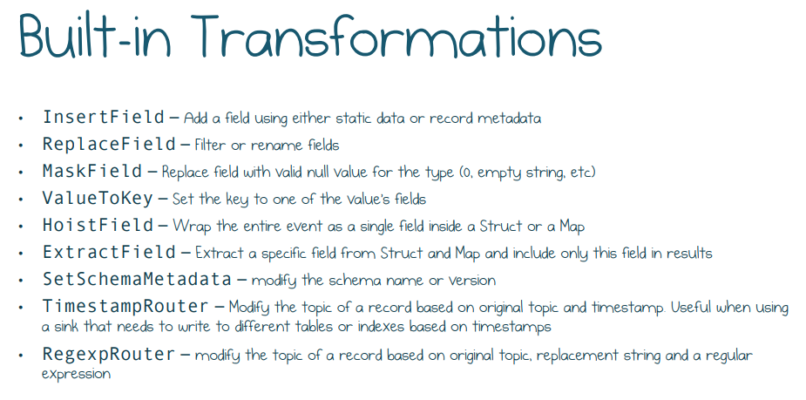

Slide 26
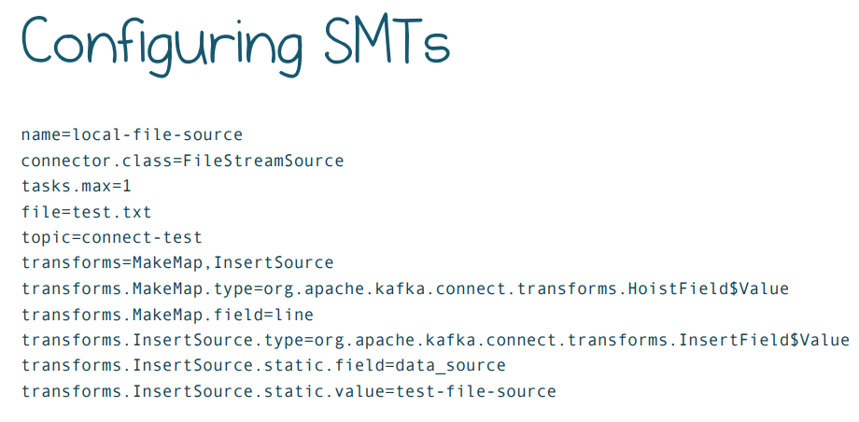

Slide 27
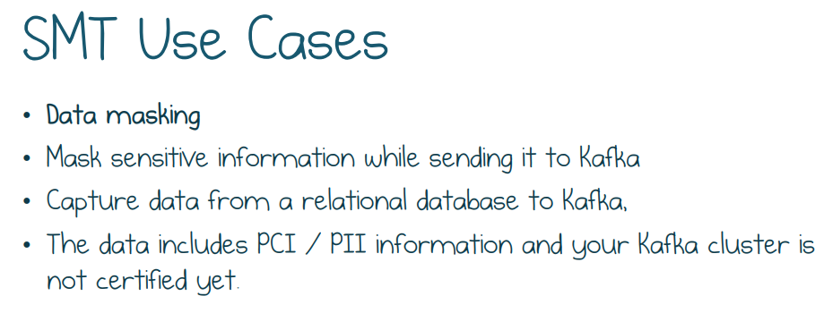

Slide 28
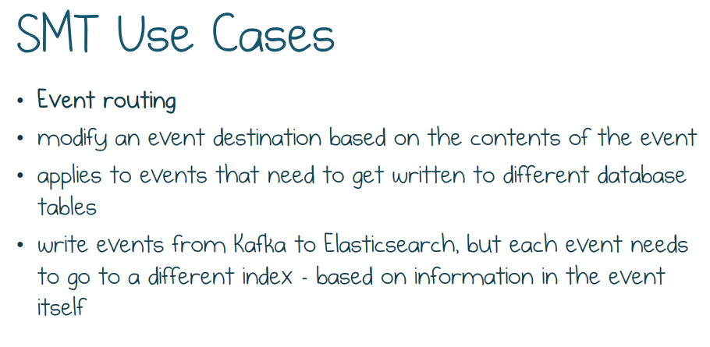

Slide 29
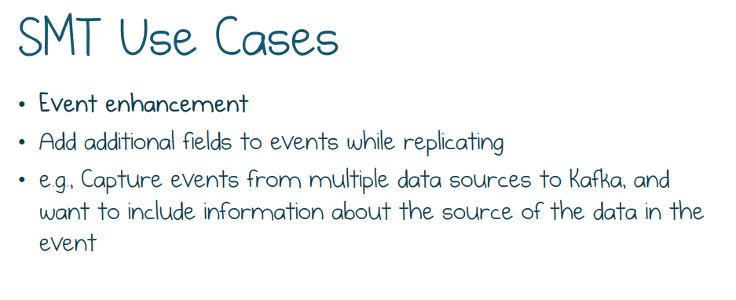

Slide 30
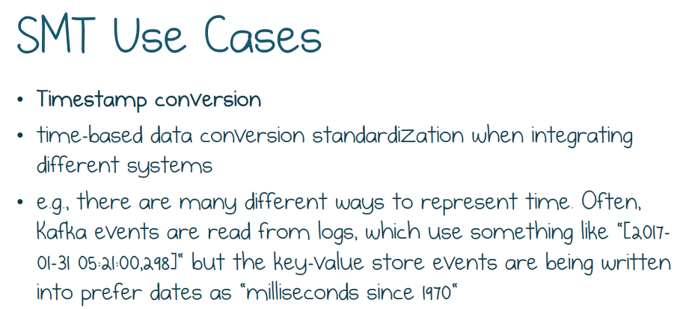

Slide 31
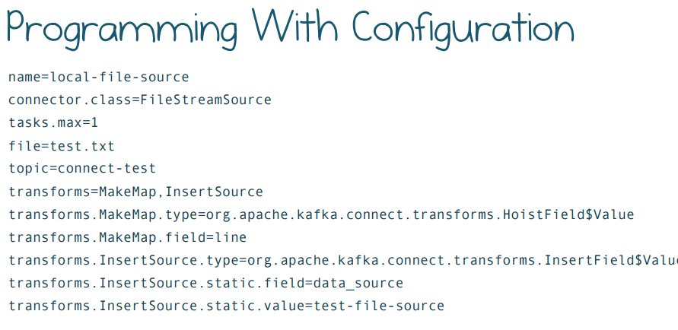

Slide 32
https://www.confluent.io/hub/
confluent-hub install <owner>/<component>:<version>
<owner> is the name of component owner on Confluent Hub.
<component> is the name of the component on Confluent Hub.
<version> is either the version of the component on Confluent Hub or the literal latest when you just want to install the latest version of the component.

Slide 33
Plugins
Kafka Connect finds the plugins using a plugin path defined as a comma-separated list of directory paths in the plugin.path worker configuration property. The following shows an example plugin.path worker configuration property:
plugin.path=/usr/local/share/kafka/plugins ------ in config file
export CLASSPATH=/path/to/my/connectors/* --while start
bin/connect-standalone standalone.properties new-custom-connector.properties

Slide 34
Running Workers
Standalone Mode
bin/connect-standalone worker.properties connector1.properties [connector2.properties connector3.properties ...]
If you run multiple standalone workers on the same host machine, the following two configuration properties must be unique for each worker
offset.storage.file.filename: the storage file name for connector offsets.
rest.port: the port the REST interface listens on for HTTP requests. This must be unique for each worker running on one host machine.

Slide 35
Distributed Mode
Connect stores connector and task configurations, offsets, and status in several Kafka topics. These are referred to as Kafka Connect internal topics.
# config.storage.topic=connect-configs
# offset.storage.topic=connect-offsets
# status.storage.topic=connect-status
Bootstrap.servers
Plugin.path
Group.id
./bin/connect-distributed --deamon worker.properties

Slide 36
JDBC connector
Step 1:- check jdbc connector jar files in plugin path, in not install it.
confluent-hub install confluentinc/kafka-connect-jdbc:latest or manual or copy
Step;2
JDBC drivers for each type move to same directory in plugin path in jdbc
https://dev.mysql.com/downloads/connector/j/
https://www.oracle.com/technetwork/database/application-development/jdbc/downloads/index.html
If the kafka-connect-jdbc JAR is located elsewhere, then use plugin.path to point to the folder containing it and make sure that the JDBC driver is in the same folder
Step3 : Restart connector if it run .

Slide 37
curl -X POST http://localhost:8083/connectors -H "Content-Type: application/json" -d '{
"name": "jdbc_source_mysql_01",
"config": {
"connector.class": "io.confluent.connect.jdbc.JdbcSourceConnector",
"connection.url": "jdbc:mysql://mysql:3306/demo",
"connection.user": "connect_user",
"connection.password": "asgard",
"topic.prefix": "mysql-01-",
"mode":"bulk"
}
}'

